Slide 1
SAURAV K S
214367@ust-global.com

Slide 2
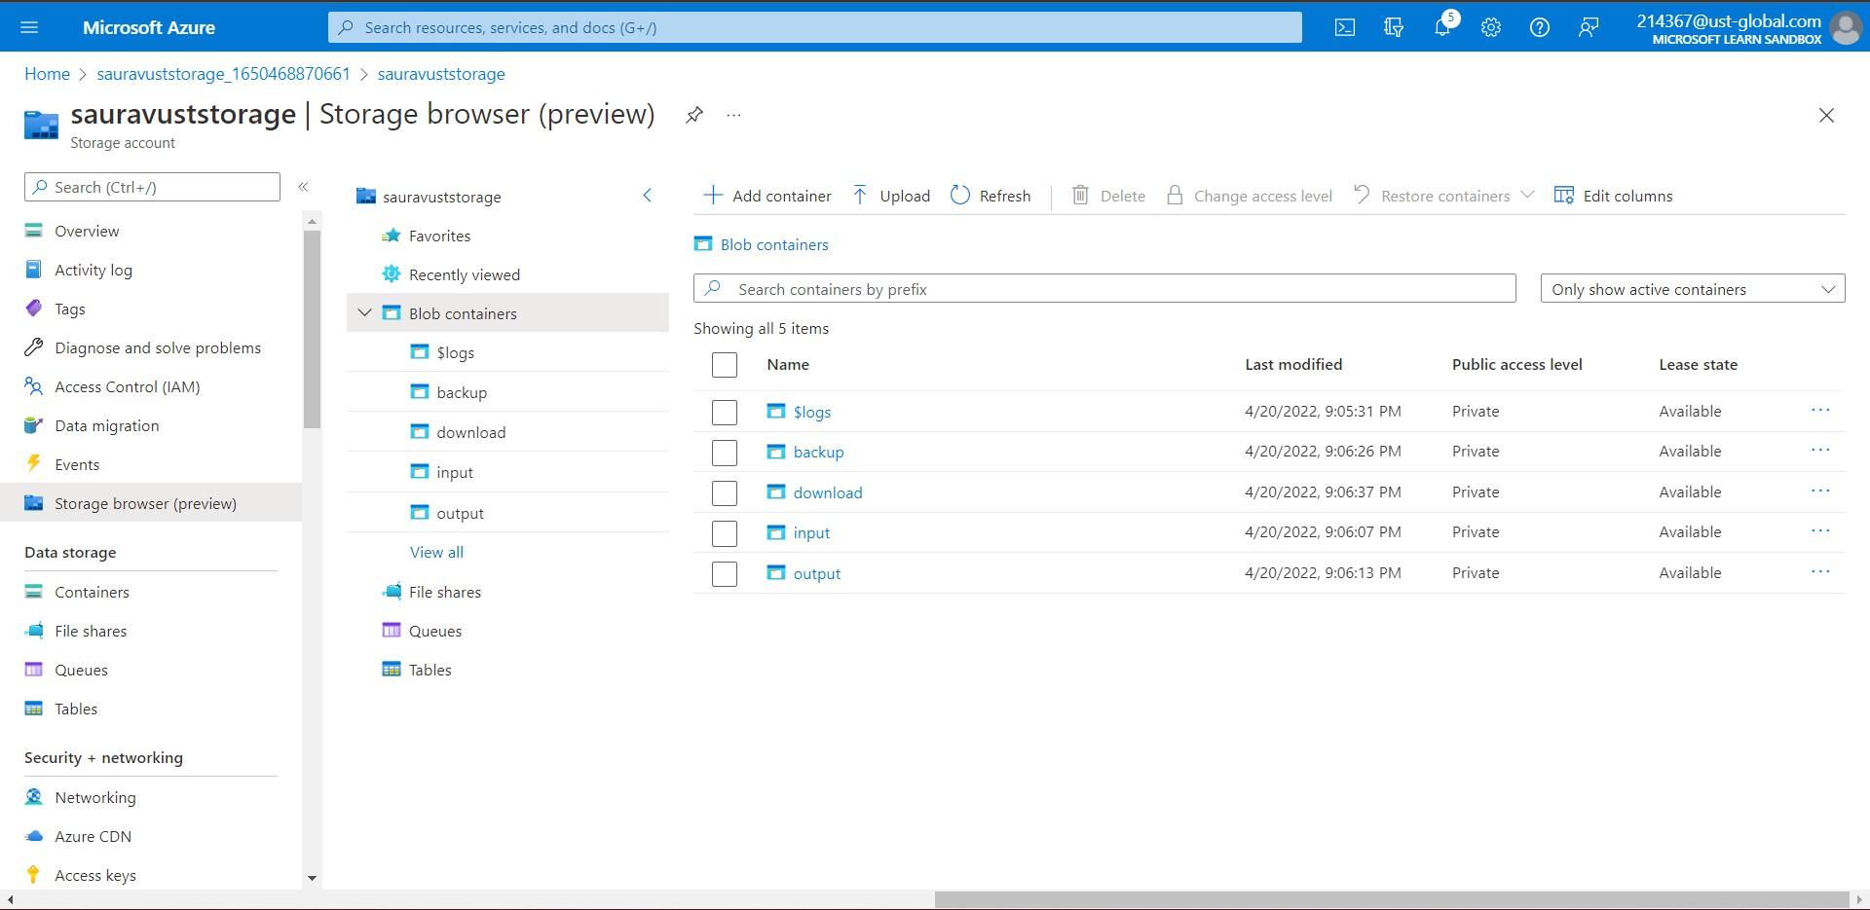
STORAGE ACCOUNT IN AZURE WITH FOUR CONTAINERS

Slide 3
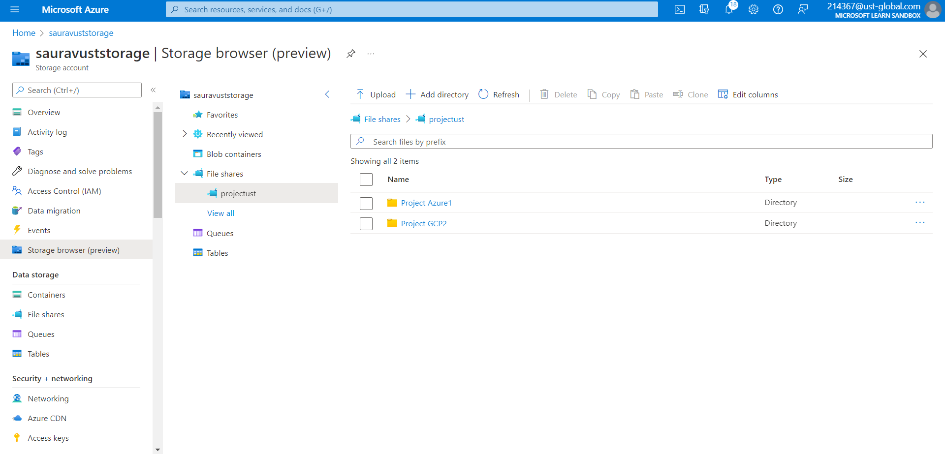
FILE SHARE WITH TWO DIRECTORIES

Slide 4
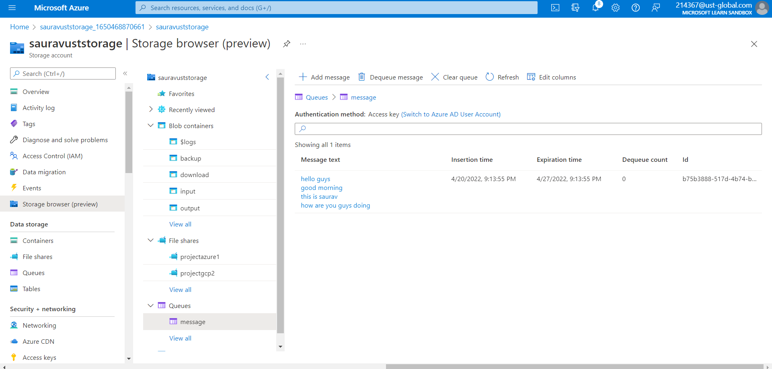
MESSAGE QUEUE WITH A MESSAGE

Slide 5
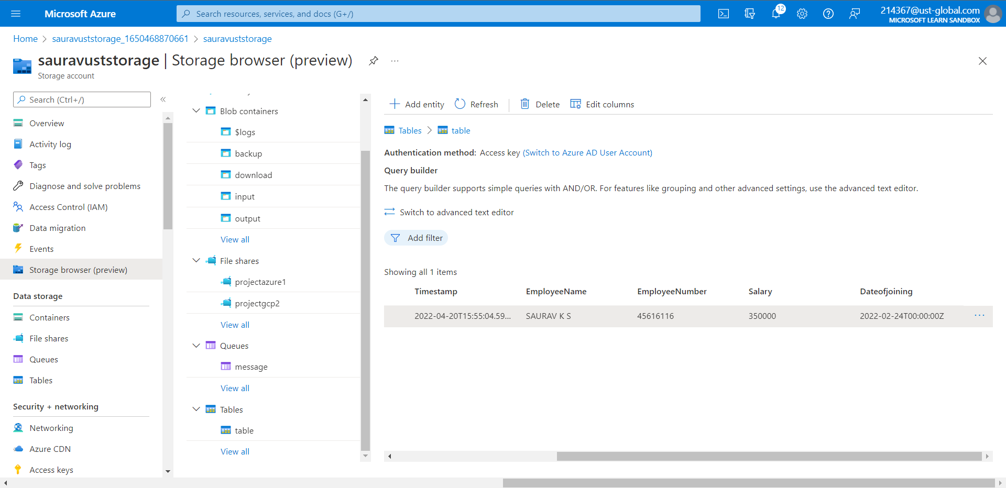
TABLE

Slide 6
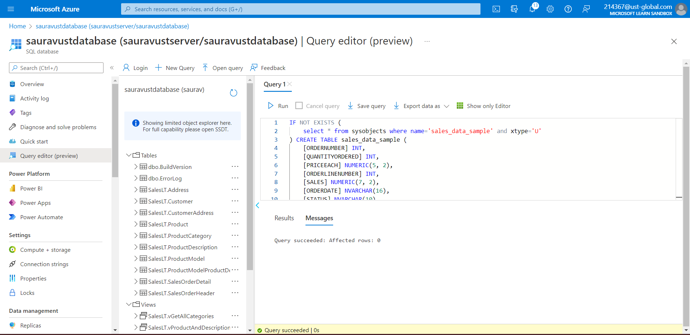
SAMPLE DATABASE WITH QUERY

Slide 7
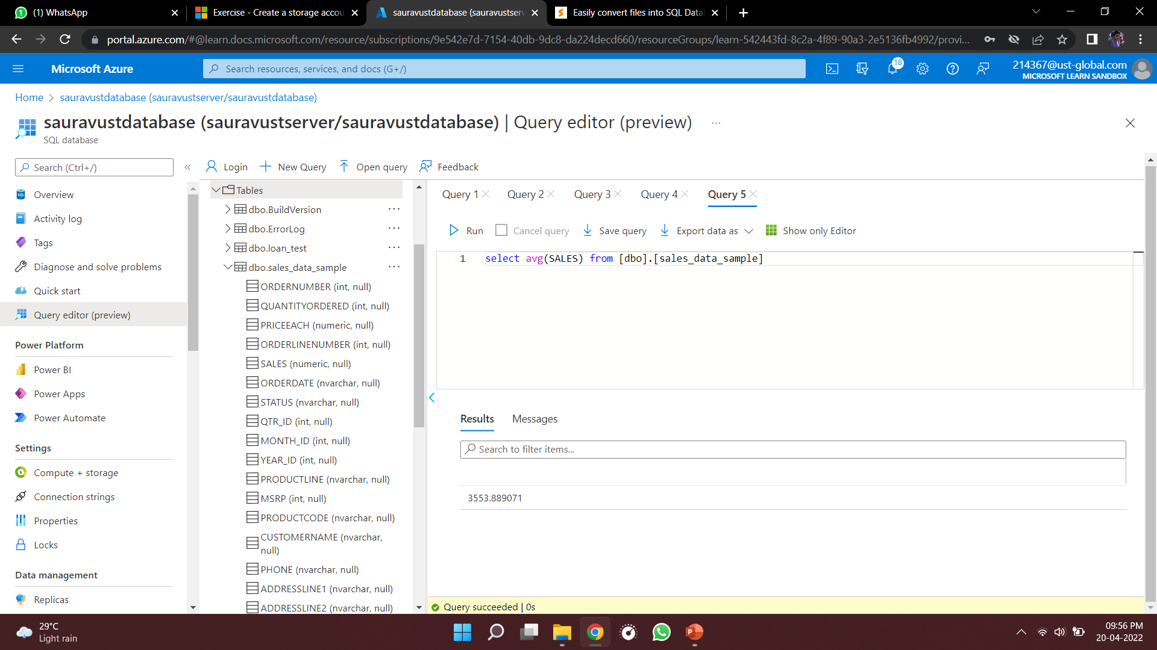
SAMPLE DATABASE WITH DIMENSIONS AND FACT TABLES – TO ESTIMATE UNIT SALES OF RETAIL GOODS

Slide 8
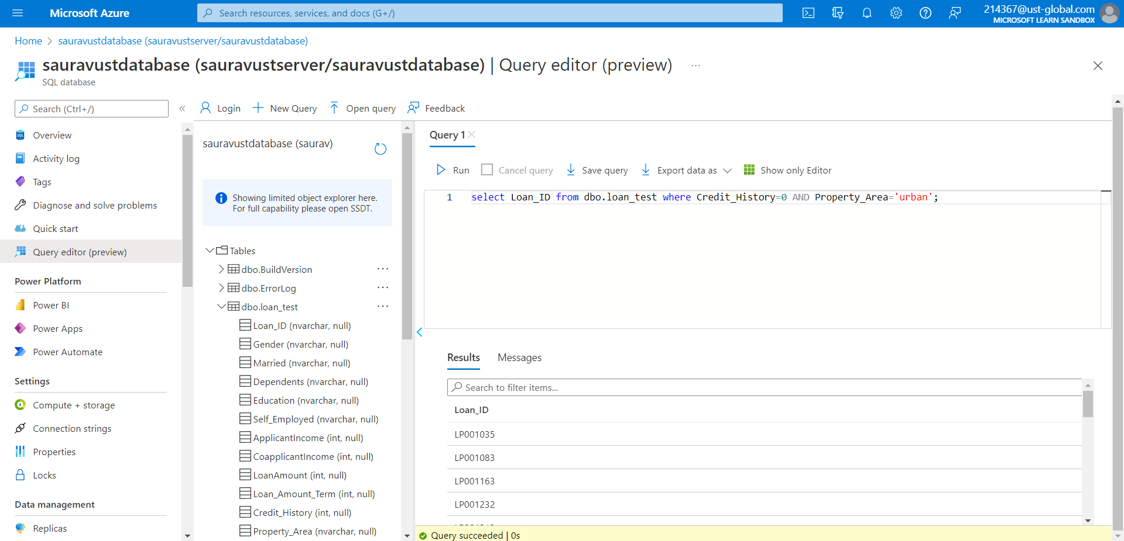
SAMPLE DATABASE WITH DIMENSTIONS AND FACT TABLES – FINANCIAL NEED PROGRAMS FOR CONSUMER LOAN PRODUCTS

